Slide 1

Devify Web Application
-Astha Gupta

Slide 2

Introduction
A comprehensive online shopping platform built using the MERN stack—MongoDB, Express.js, React, and Node.js. The project is designed to offer a smooth and intuitive shopping experience, equipped with key features like product browsing, advanced search and filtering, and secure user authentication. Additionally, there’s an admin panel that provides control over product, user, and order management.

Slide 3
Overview of the Project
Technology Used
Key Features
Frontend: React, Tailwind CSS
Backend: Node.js, Express.js
Database: MongoDB State Management: Redux
Cloud Image Storage: Cloudinary ​
Product browsing and filtering
User authentication (JWT-based)
Admin panel for product, order, and user management
Shopping cart with quantity management
Secure payments via Stripe

Slide 4
Frontend Development
React & Tailwind CSS:
Developed a responsive and interactive user interface.
Used Tailwind CSS for streamlined styling and a modern look and feel.
Features include:
Product browsing: Users can view a catalog of products.
Product filtering: Filter by category, price, and rating.
Product detail page: Includes an image carousel and detailed product info.
Shopping cart: Real-time management of cart items, including quantity adjustments.

Slide 5
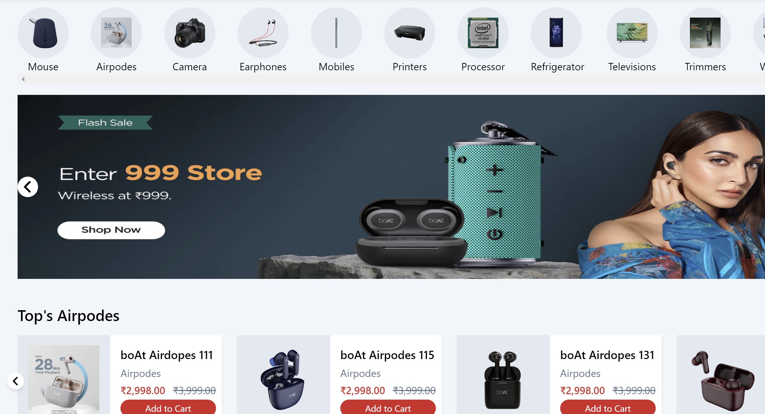
Frontend Development
Redux for State Management
Managed global states such as user authentication and shopping cart contents.
Ensured efficient state sharing across the application, allowing for a smooth user experience.

Slide 6
Backend Development
Node.js & Express.js
MongoDB for Data Storage
Built a RESTful API to handle all backend logic, including:
User registration and login using JWT for secure sessions.
Product retrieval, adding to cart, and order management.
Organized the application structure to maintain scalability and modularity.
Used MongoDB to store:
Product details, including images, prices, and stock levels.
User information, such as passwords (hashed), addresses, and order history.
Transaction history and order details.

Slide 7
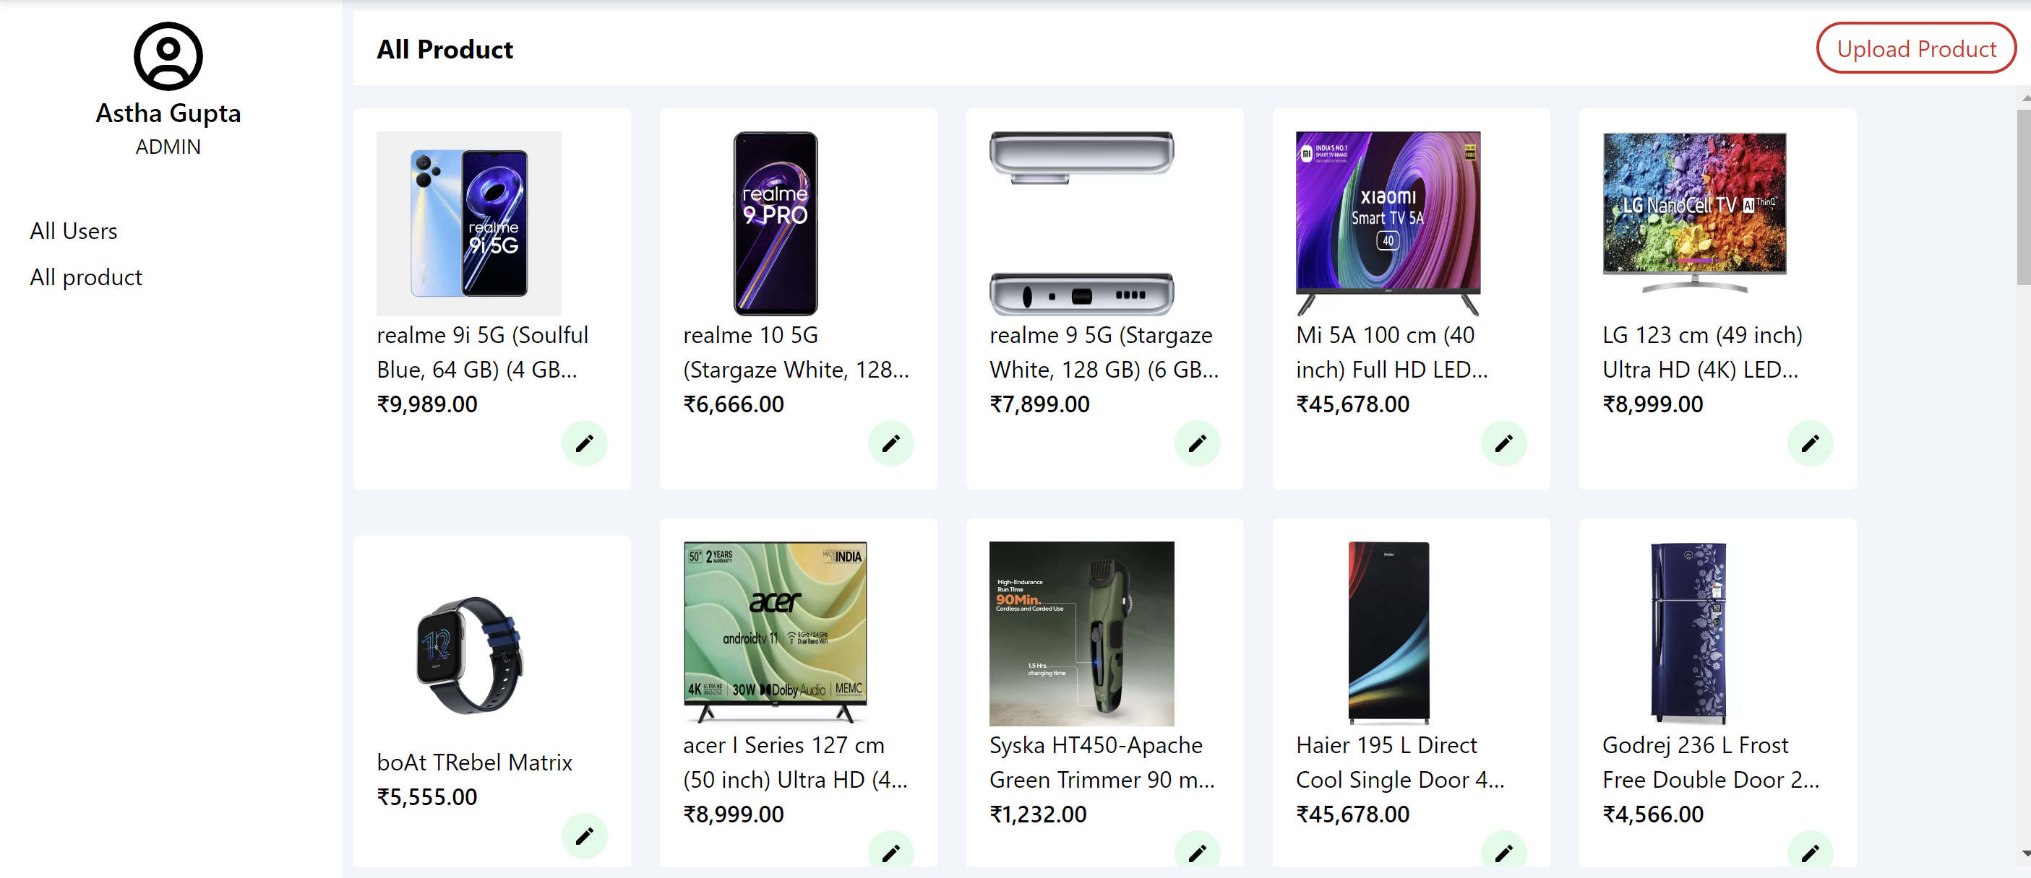
Admin Panel Features

Slide 8
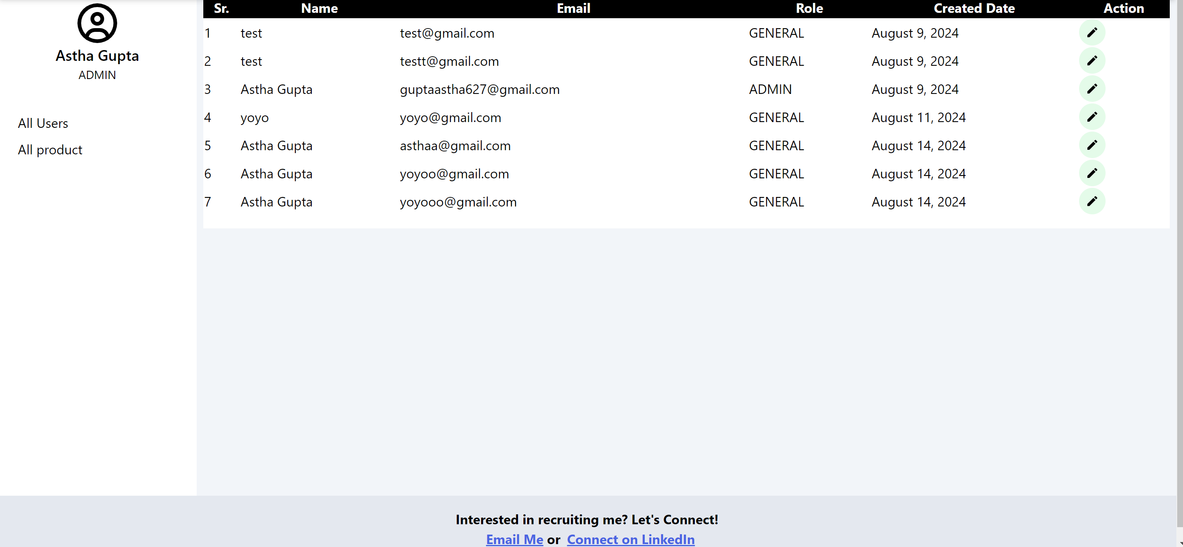
User Admin Panel

Slide 9

Thank you

